Slide 1
Estimating Housing Values With Crime Incident Reports
CMPE 255-01 Team8
Professor: David C. Anastasiu
Pavana Srinivasadeshika Achar, Aartee Kasliwal, Chia-Chin Wu
Project Github https://github.com/Aartee/housing-price-prediction

Slide 2
Agenda
Introduction and Motivation
Datasets
Data cleaning, pre-processing and feature selection
Regression models used
Evaluation
Conclusion
Demo

Slide 3
Introduction
This project intends to find correlations of the criminal incidents with the house values and predict the price for a particular house based on the crime zone or zip code.
We have used San Francisco police department incidents dataset for criminal reports and Zillow’s house value index dataset for San Francisco house values
In this prototype, we plan to use the Zillow’s dataset for training the module and test the model with listings from other agencies like Redfin and compare the prices.

Slide 4
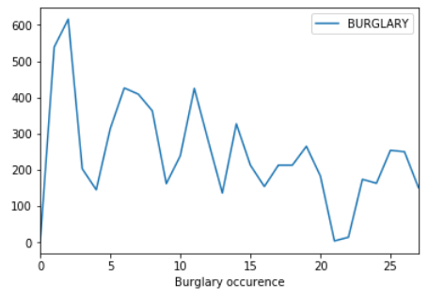
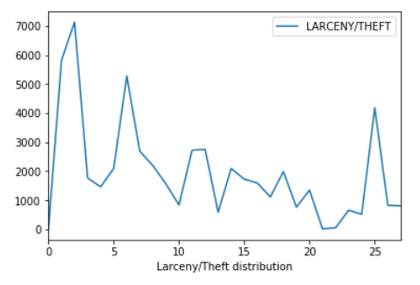
Datasets

Slide 5
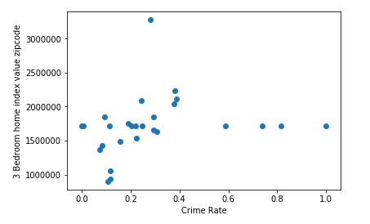
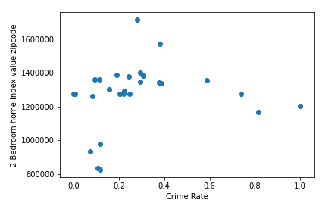
Datasets

Slide 6
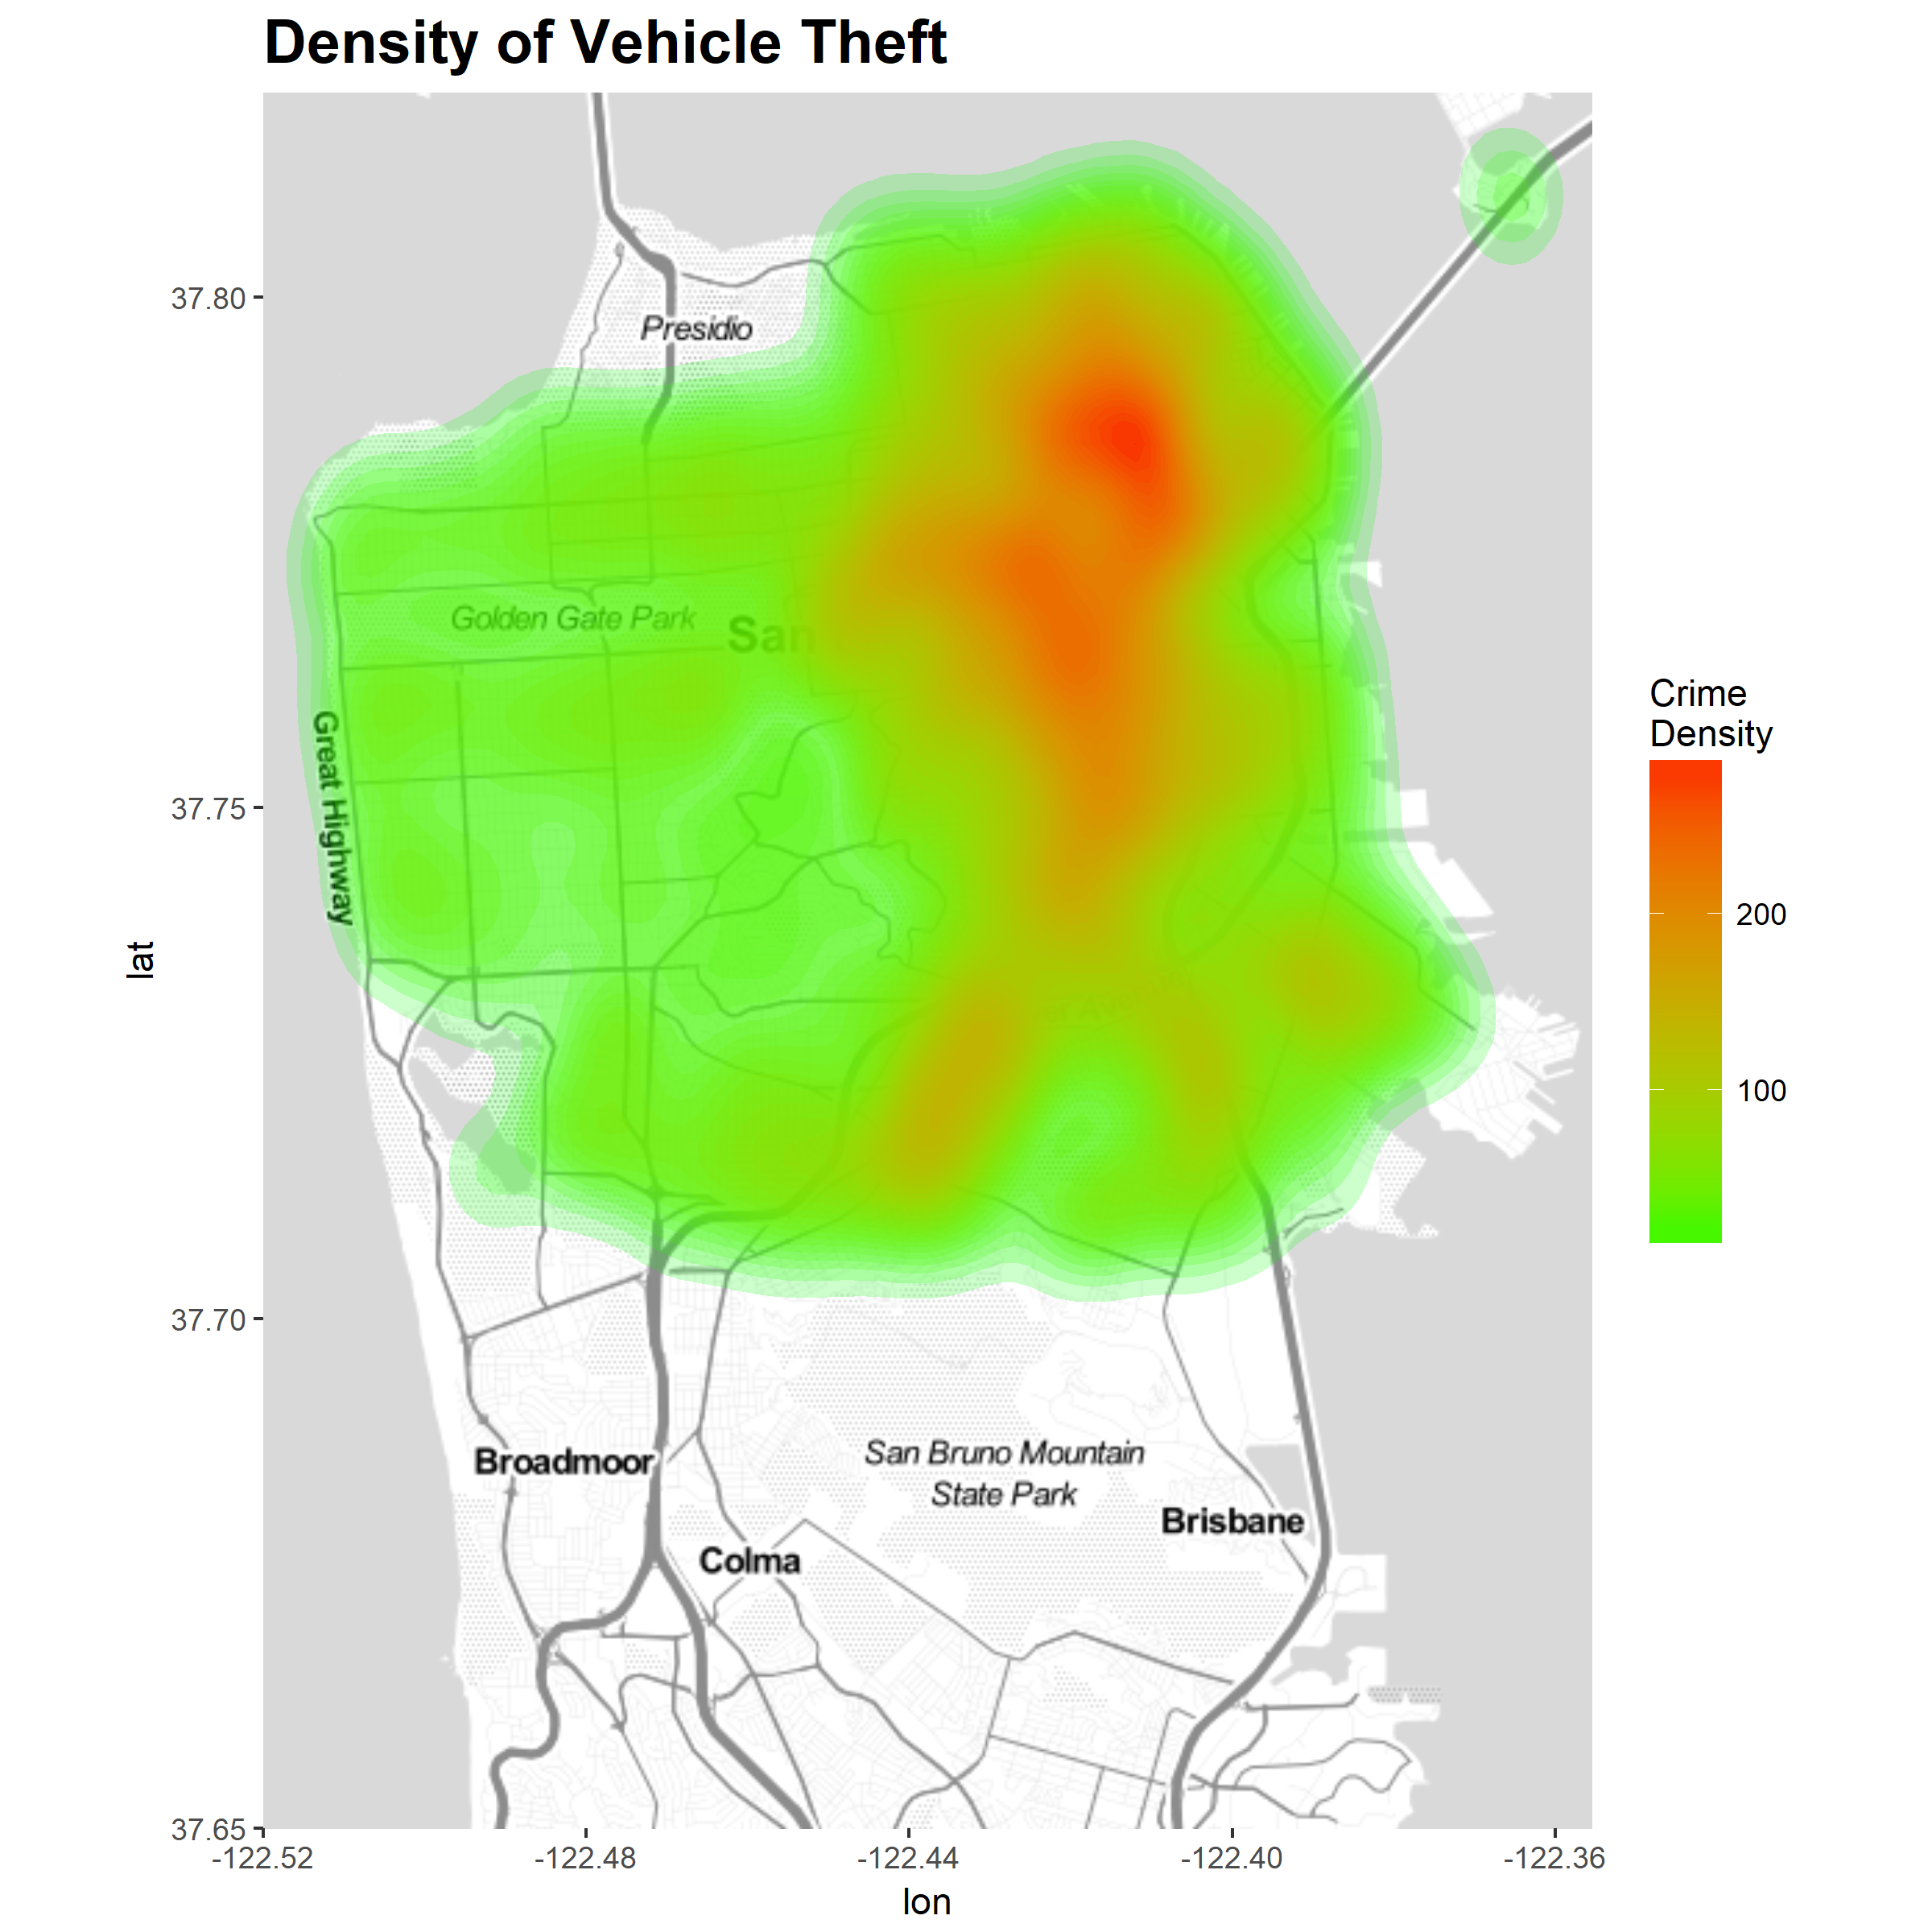
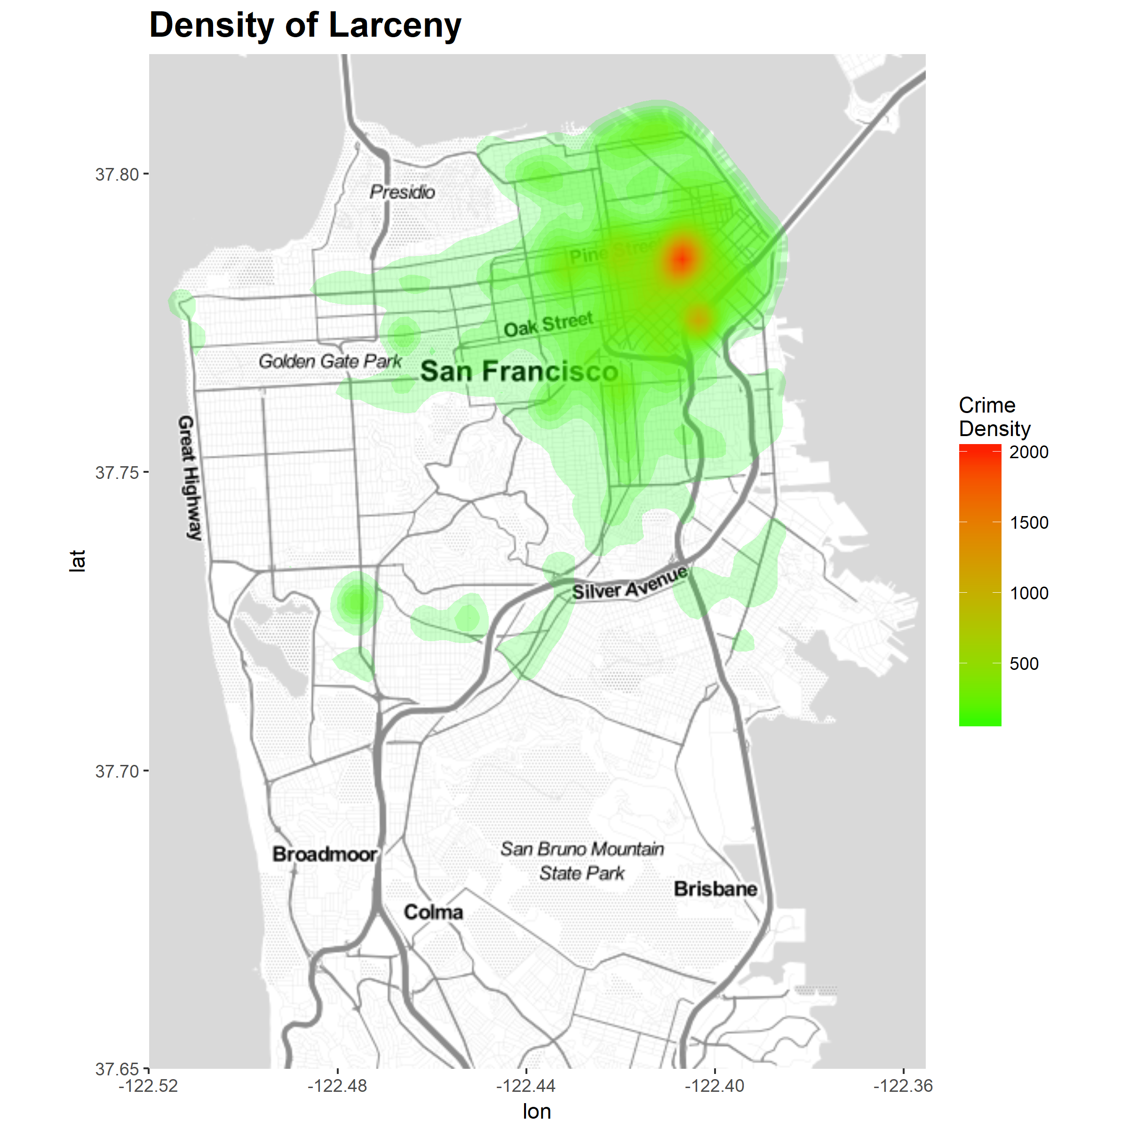
Visualization

Slide 7
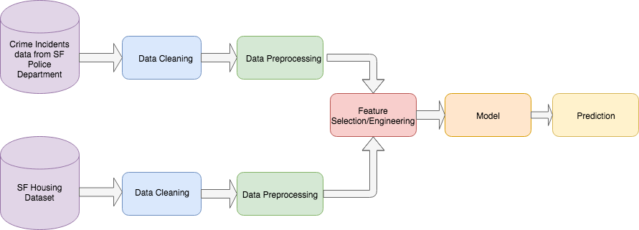
Model Flow Diagram

Slide 8
Cleaning, Pre-Processing and Feature Selection
The feature values for crime categories, latitude and longitude are extracted.
We used uszipcode module’s ZipcodeSearchEngine function to extract the zip code value for each of these location features.
These rows are grouped by zip codes.
The categories are aggregated for each group.
This data :
is transformed to have the count features of crime categories associated with zipcode on the rows.
is further cleansed for removing NaN values.
The dataset is normalized using min-max normalization technique so that each value is relative to its own column. This way a huge value in a particular feature will not be influencing the overall analysis.

Slide 9
Regression Models Used
Seven regression algorithms were implemented and evaluated to predict the housing values.
The Gradient Boost Regressor, Linear Regressor and ELastic Net resulted with least mean absolute error value.
other regression models used are:
Lasso
Linear Regressor
Ridgde Estimator
OMP Regressor
The Gradient Boost Regressor was chosen to build the model.

Slide 10
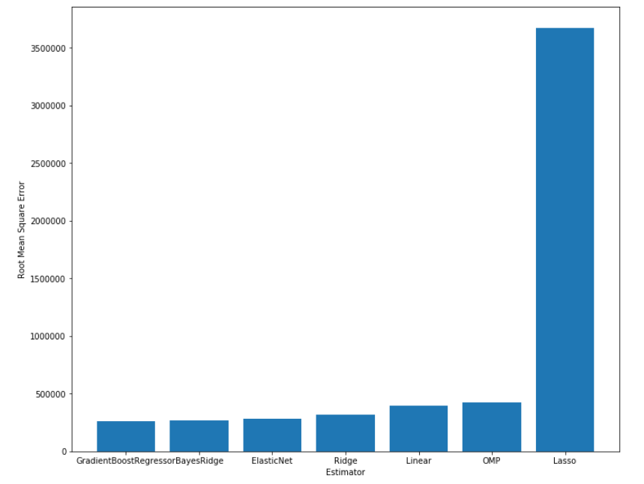
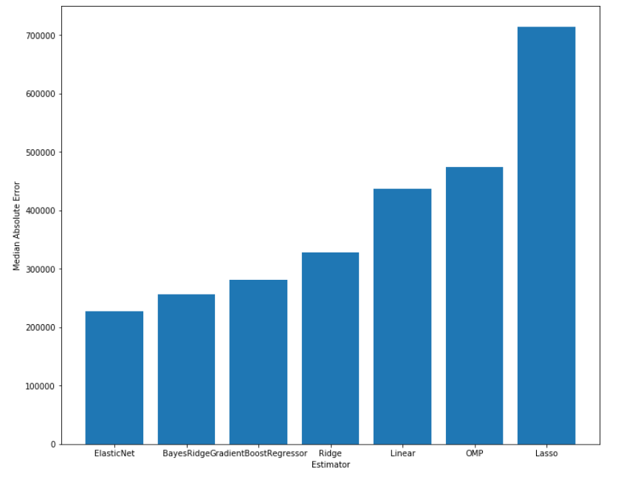
Evaluation

Slide 11
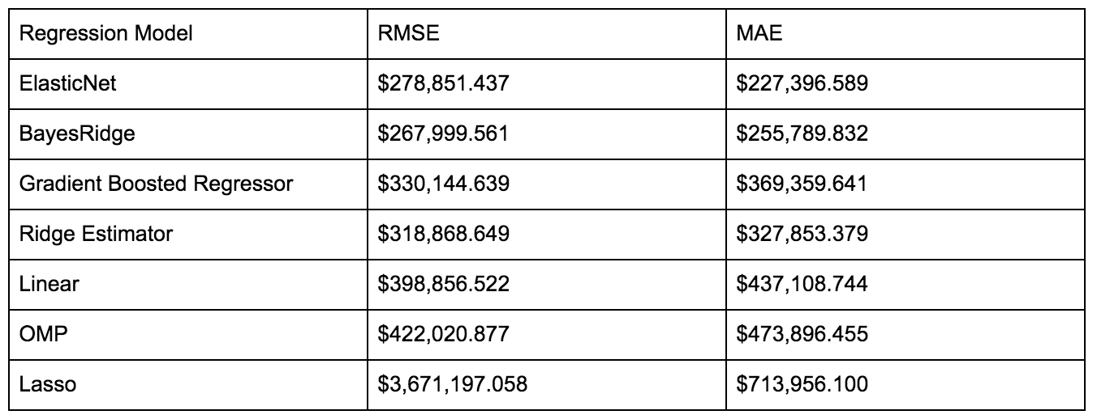
Evaluation

Slide 12
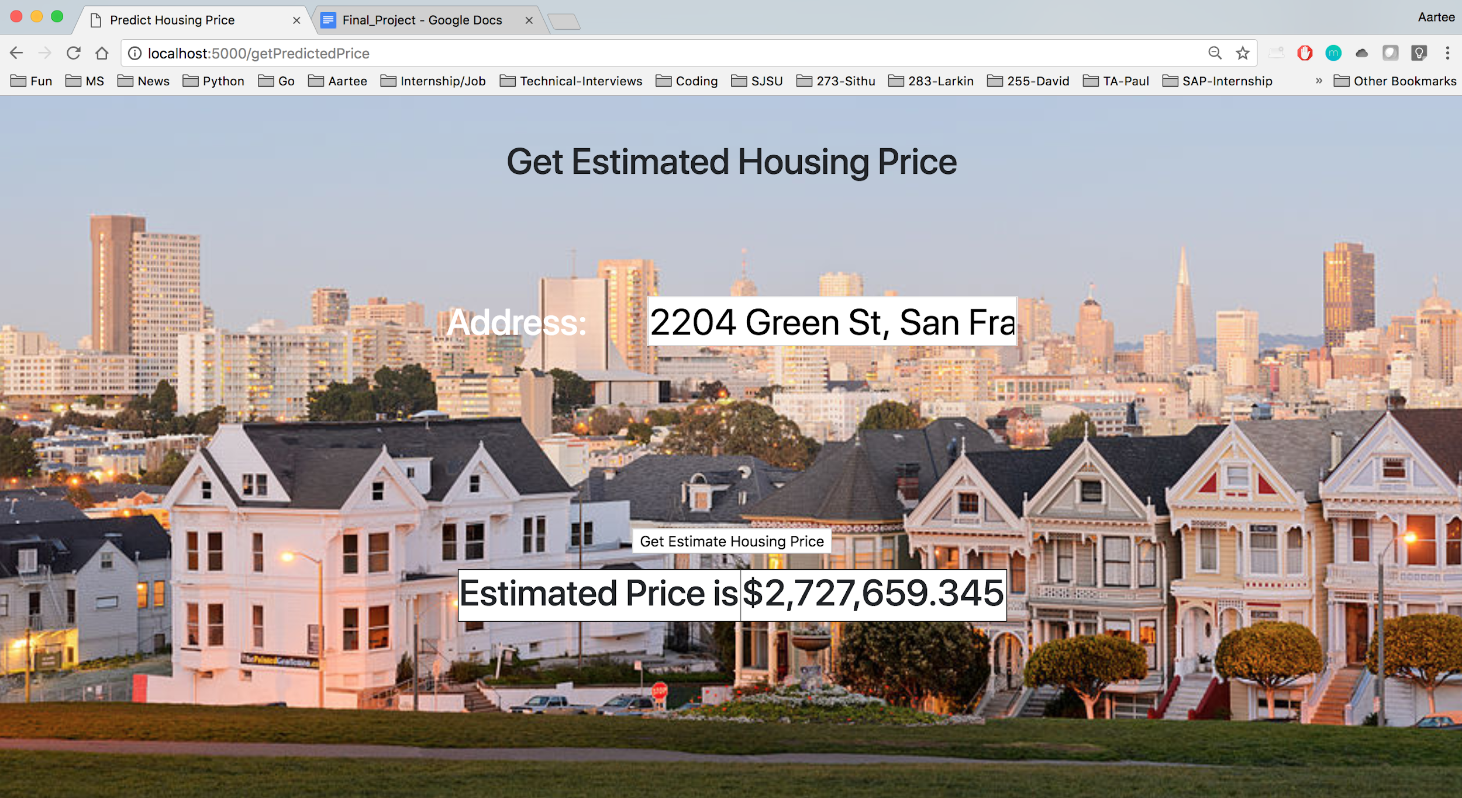
Results

Slide 13
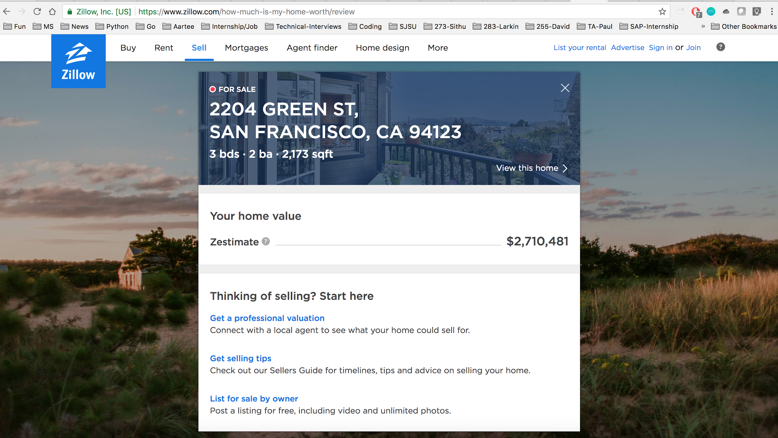
Results

Slide 14
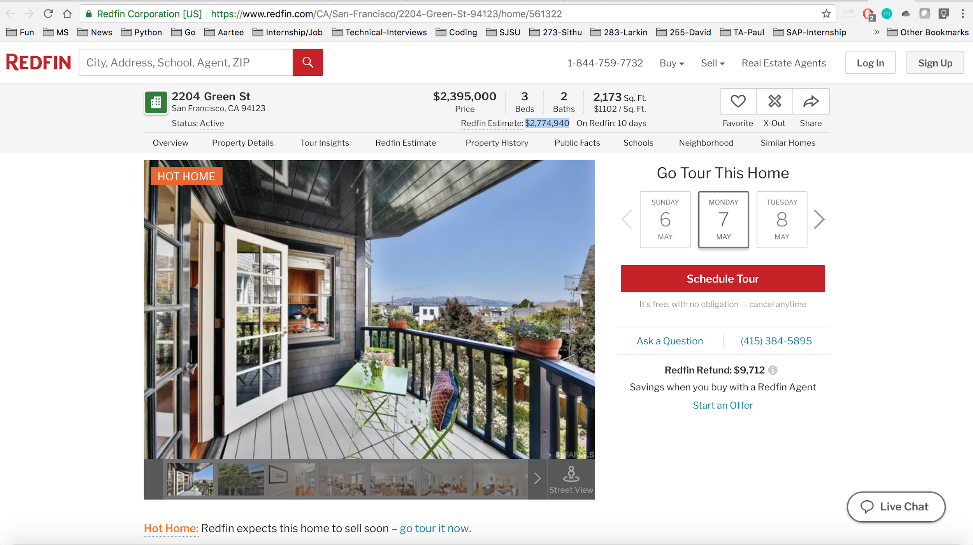
Results

Slide 15
Conclusion
This project is a predictive model to solve a regression problem of predicting house sales value based on the crime rates of the neighborhood.
We used San Francisco crime incidents dataset for the criminal records dataset and the Zillow house value dataset for housing data set.
We performed data cleaning, data preprocessing tasks before applying the model. We trained and evaluated a handful of regression models to choose the best applicable algorithm.
We used a basic front end web page to accept the address of the house and predicted the rate for the house. The results were compared with other real estate agency websites like Redfin and Zillow

Slide 16
References
[1] "Linear Regression Example — scikit-learn 0.19.1 documentation." http://scikit-learn.org/stable/auto_examples/linear_model/plot_ols.html. Accessed 6 May. 2018.
[2] "1.11. Ensemble methods — scikit-learn 0.19.1 documentation." http://scikit-learn.org/stable/modules/ensemble.html. Accessed 6 May. 2018.
[3] "Plot Ridge coefficients as a function of the regularization — scikit-learn ...." http://scikit-learn.org/stable/auto_examples/linear_model/plot_ridge_path.html. Accessed 6 May. 2018.
[4] "Orthogonal Matching Pursuit — scikit-learn 0.19.1 documentation." http://scikit-learn.org/stable/auto_examples/linear_model/plot_omp.html. Accessed 6 May. 2018.
[5] "Bayesian Ridge Regression — scikit-learn 0.19.1 documentation." http://scikit-learn.org/stable/auto_examples/linear_model/plot_bayesian_ridge.html. Accessed 6 May. 2018.
[6] "Lasso and Elastic Net — scikit-learn 0.19.1 documentation." http://scikit-learn.org/stable/auto_examples/linear_model/plot_lasso_coordinate_descent_path.html. Accessed 6 May. 2018.

